Slide 1
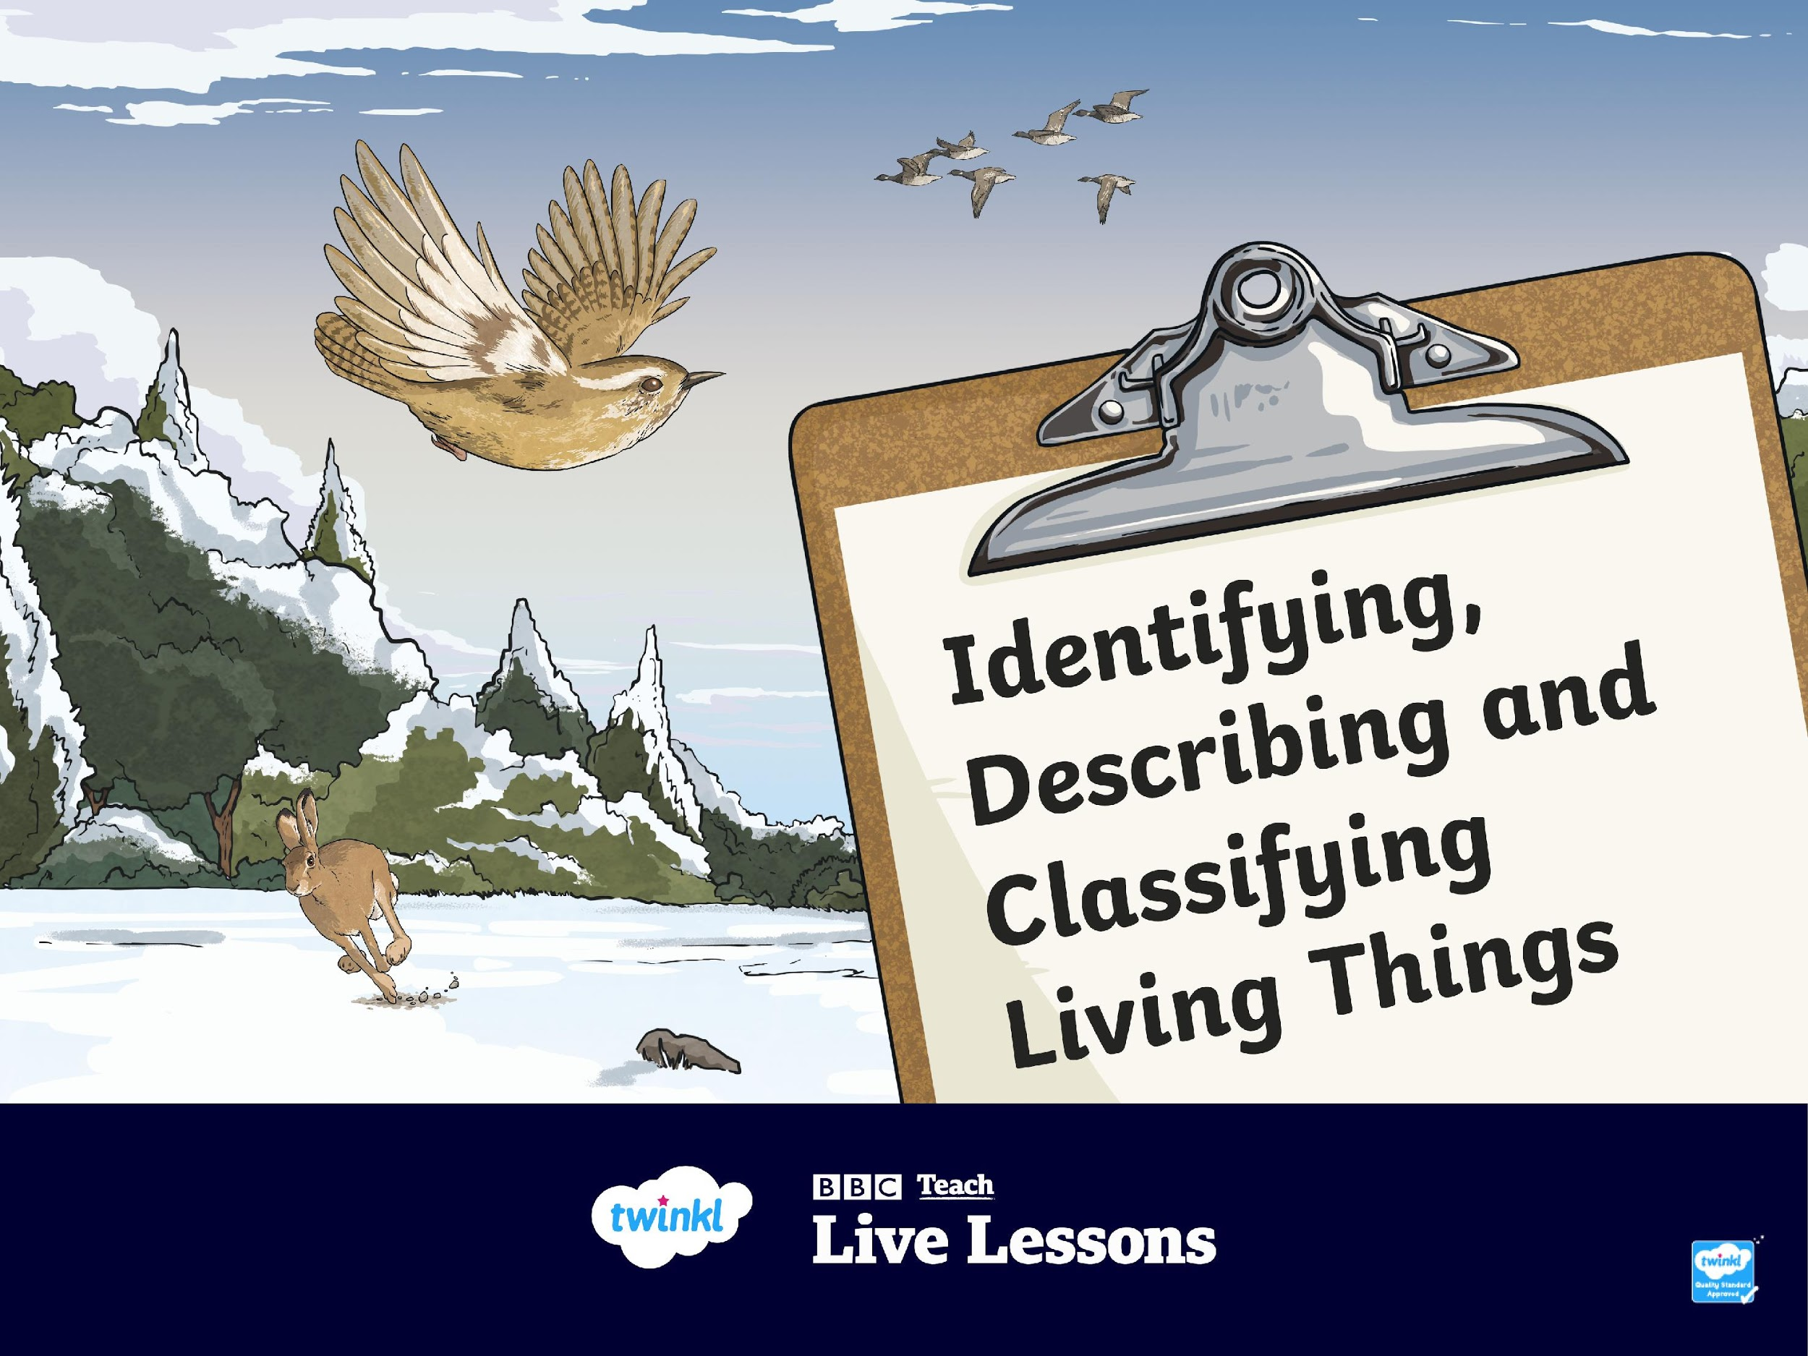


Slide 2
Watch the BBC Teach Big Schools Winterwatch Live Lesson

Slide 3
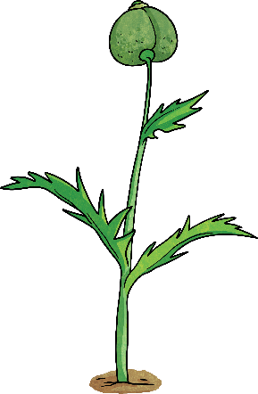
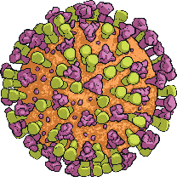
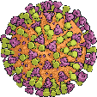
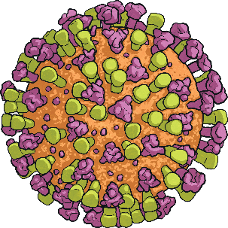
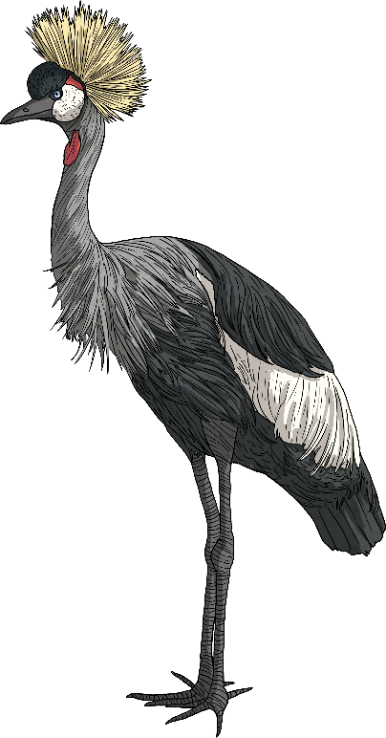

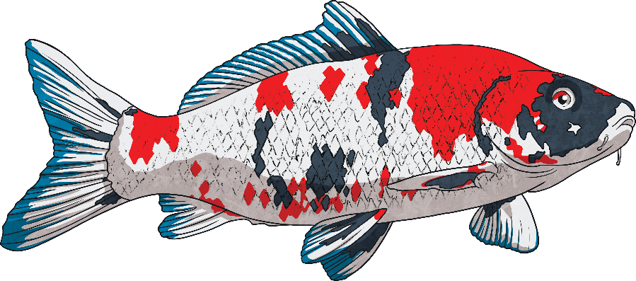
Worldwide, there are estimated to be over 15 million different species of living things although scientists estimate that only two million have so far been discovered!
With all those species, how can we possibly identify and name each different living thing to distinguish it from another?
We only have to glance through a window, walk through a woodland, gaze into a pond or look up to the sky to spot different species of plants and animals in the UK. Each species has different features that can help us to identify and name it.

Slide 4
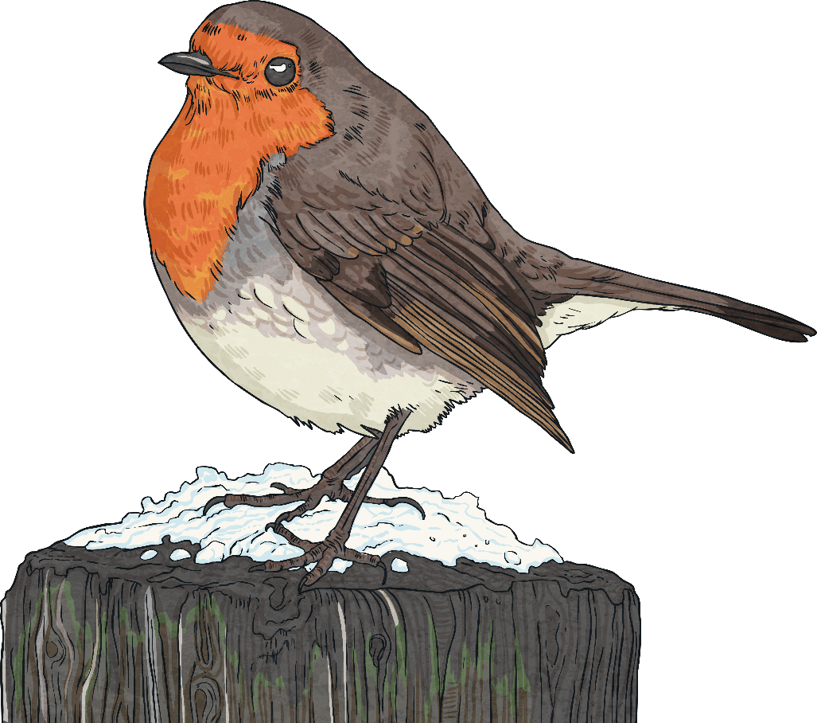
Many species share similar features: birds, for example, all share physical characteristics and physiological characteristics (related to the way they function).
We can use careful observation of the colour, size and shape of their physical features to narrow down the species of bird.
How many of the features below can you identify?

Slide 5
Click on each of the features to see whether you were right.
Crown
Beak
Tail
Beak
Claws
Breast
Wings
Tail
Claws
Crown (top of a bird’s head)
Wings
Breast (chest of the bird)
All birds have beaks, feathers, two legs and two wings, and those that can fly have special feathers, called flight feathers, on their wings and tail to help them fly. Interestingly, birds that cannot fly, such as ostriches and penguins, do not have these but have adapted to move in other ways: ostriches’ legs are longer than any other bird’s so they can run very fast, while penguins have webbed feet for swimming.

Slide 6
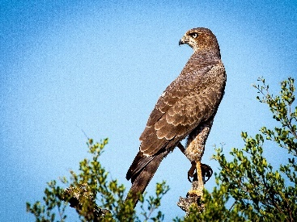
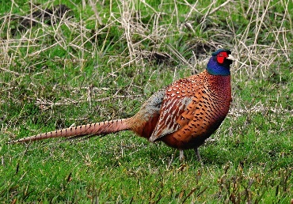
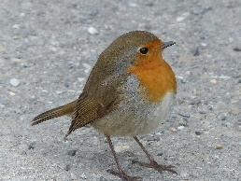
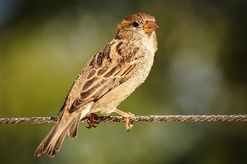
Once we can recognise different features, we can use these to classify (sort) living things using a classification key.
This is a series of questions that help us to identify a living thing or decide which group it belongs to, based on its characteristics.
A classification key to sort birds, for example, might look like this:
Birds
Yes
Is it a predator?
No
Yes
Falcon
Does it have long tail feathers?
No
Yes
Does it have a red or orange breast?
Pheasant
No
Robin
Sparrow

Slide 7
A classification key to sort birds, for example, might look like this:
Birds
Yes
Is it a predator?
No
Yes
Falcon
Does it have long tail feathers?
No
Yes
Does it have a red or orange breast?
Pheasant
No
Robin
Sparrow
Good questions to use in a classification key ask about the physical features, size and appearance of living things, as well as their habitats. If your classification key is detailed enough, it could even help you to identify an unknown living thing!

Slide 8
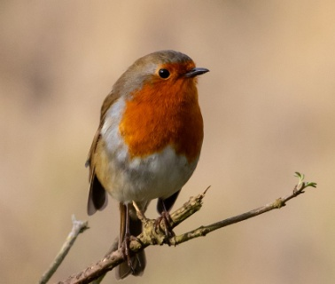
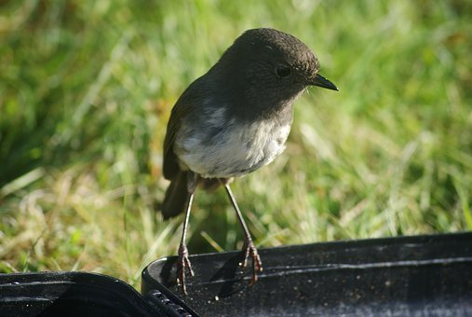
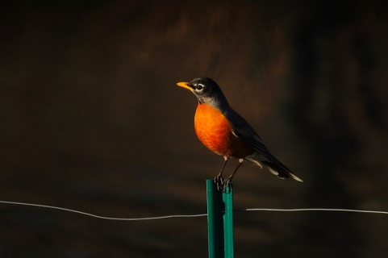
Since there are so many millions of species, many of which share similar features, scientists use a system called the binomial system to classify (group) living things into five kingdoms, which include animals and plants.
These kingdoms are then broken down into smaller levels:
Phylum
Family
Class
Genus
Order
Species
The binomial system categorises living things so well that it allows scientists to identify individual species easily. For example, there are many different species of robin all over the world, such as the Erithacus rubecula (European robin), Petroica australis (New Zealand robin) and Turdus migratorius (American robin). These all belong to a different genus.

Slide 9
After you’ve learned how to identify, describe and classify living things, it might be helpful to others if you can pass on what you’ve learnt.
We find instruction texts that help us to understand how to do something all around us: internet video tutorials, recipe books, how-to guides, product demonstrations and video game walk-throughs are just a few examples of these.
Why not create a how-to guide to help others learn about identifying living things?
Can you identify some features that we might expect to see in a how-to instructional text?
Checklist
Title
Time conjunctions
Introduction
Technical language
Instructions sequenced logically
Diagrams or photographs
Present tense
Concluding statement
Imperative verbs

Slide 10
How many of those features can you identify in the instructional text below?
How to Identify Different Species
Title – this should capture the imagination of the reader. Try to make it something that the reader will learn how to do from the text.
Worldwide, scientists believe there are over 15 million different species (types) of living things although only two million have so far been discovered! With all those species, how can we possibly identify and name each different one?
Introduction – this should be a short paragraph giving some background information and explaining what the guide will teach the reader.

Slide 11
Imperative verbs – these tell the reader what to do now.
First, use careful observation whenever you are outside to keep a look out for different species, especially ones you haven’t seen before.
Next, take note of physical features: sizes, shapes, colours and particularly anything that stands out as different from other living things.
Finally, jot down where you are as the habitat can help you to identify what species you see.
Instructions sequenced logically – these will be in chronological order.
Time conjunctions – these help the reader to know in what order to do things.
Technical language – this should be relevant to the topic being discussed.

Slide 12
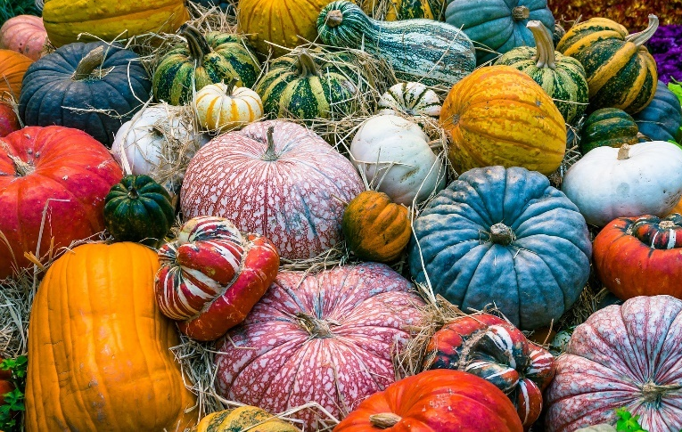
Diagrams or photographs – these help the reader to see things discussed in the text.
Different species can vary in shape, size and colour.
Now that you have lots of information, you can start to identify the species you have seen using a classification key, fact file, encyclopaedia or similar search tools.
Concluding statement – this encourages the reader to take action!

Slide 13
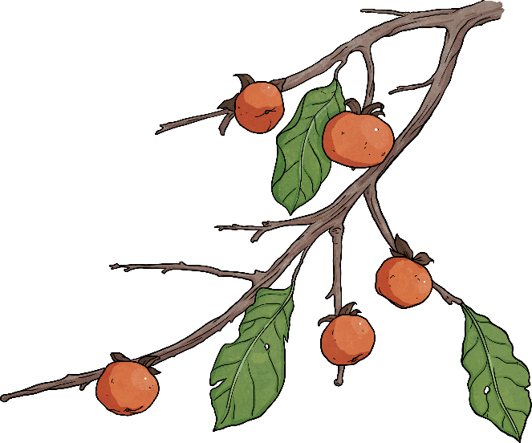
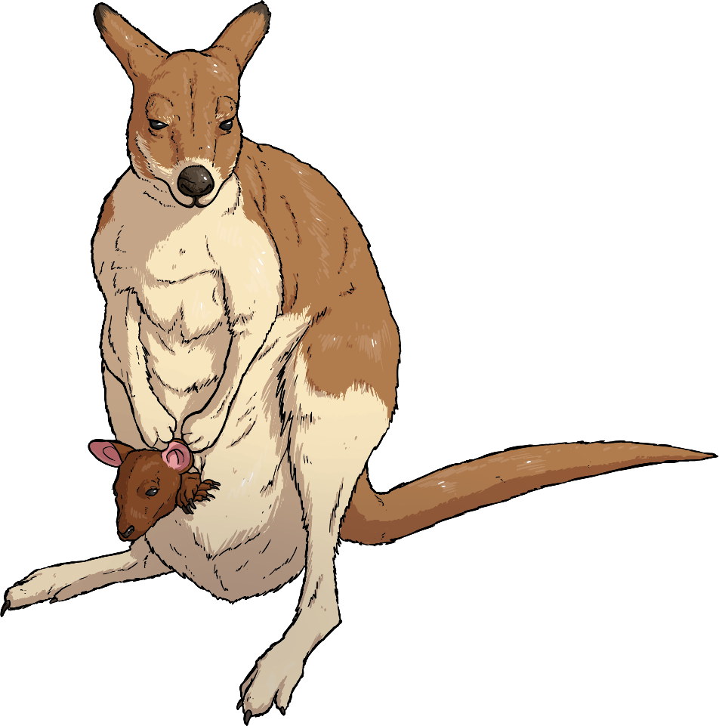
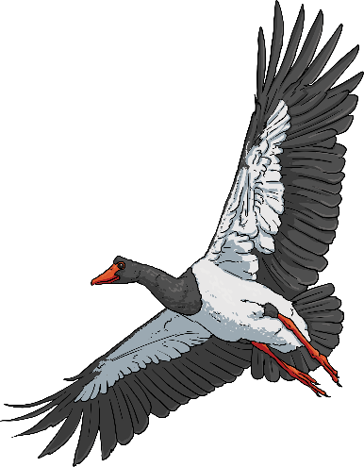
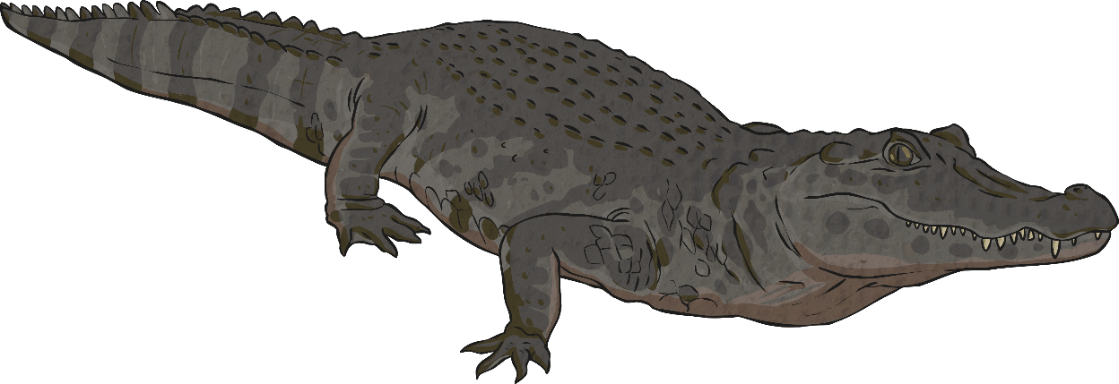
So now you have all the tools you need to identify, describe and classify living things.
Wherever we live, visit or go to school, there is likely to be a huge number of different species we can identify if we look carefully enough.
Try putting what you have learnt into practice in your local area, perhaps with a plant study, insect survey or birdwatch.

Slide 14


